Slide 1
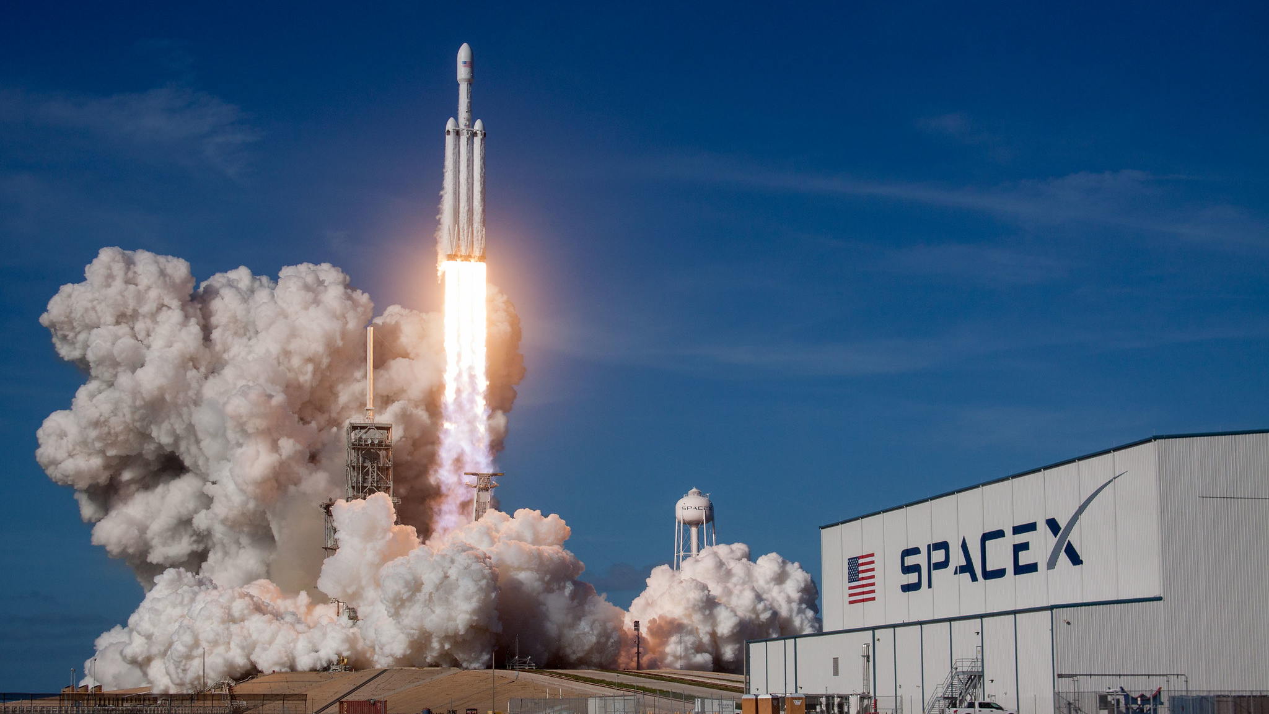
SpaceX Falcon 9 first stage Landing Prediction
Vershinskaya Elena
September 8th, 2024

Slide 2
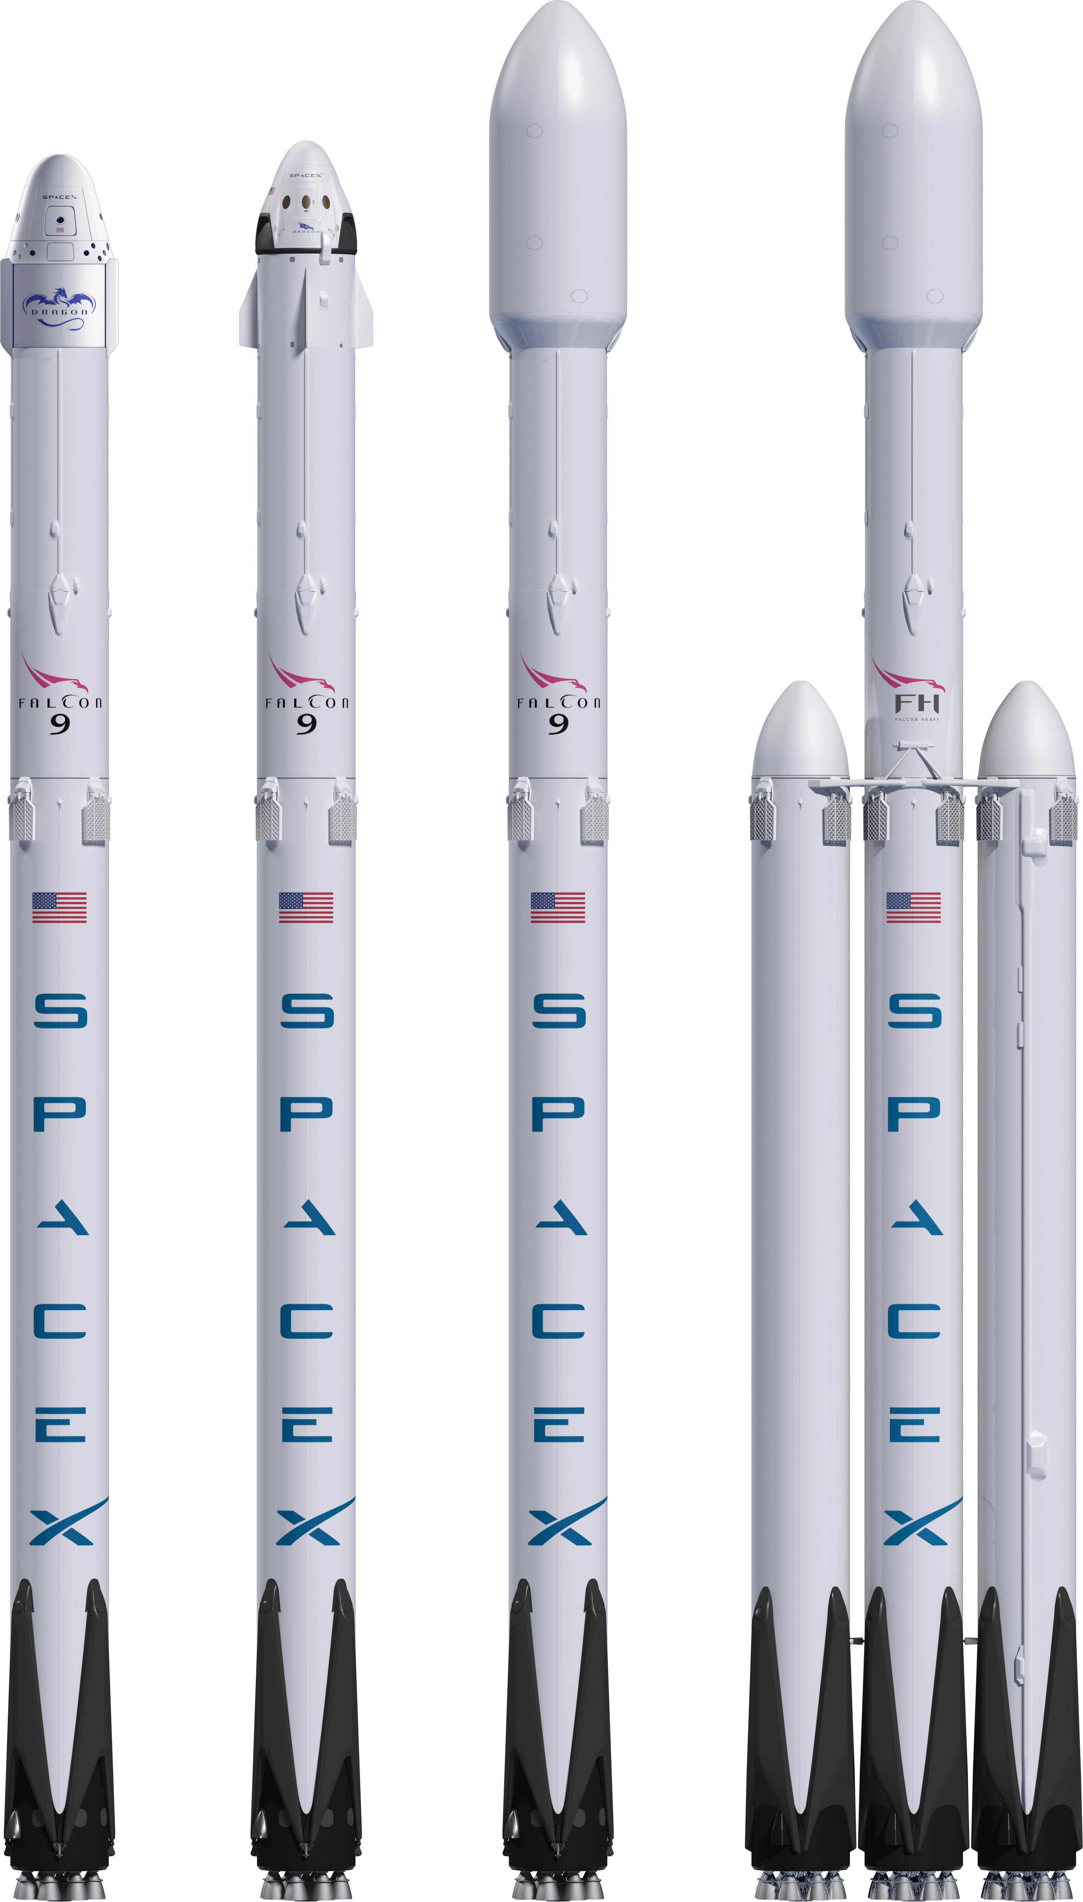
Content
Introduction
Data collection and data wrangling methodology
EDA with visualization results
EDA with SQL results
Interactive map with Folium results
Plotly Dash dashboard results
Predictive analysis (classification) results
Conclusion

Slide 3
Introduction
We would like to predict if the Falcon 9 first stage will land successfully.
SpaceX advertises Falcon 9 rocket launches on its website with a cost of 62 million dollars; other providers cost upward of 165 million dollars each, much of the savings is because SpaceX can reuse the first stage.
Therefore if we can determine if the first stage will land, we can determine the cost of a launch.
This information can be used if an alternate company wants to bid against SpaceX for a rocket launch.

Slide 4
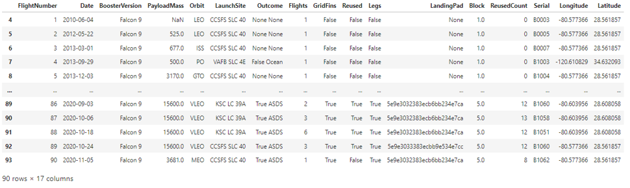
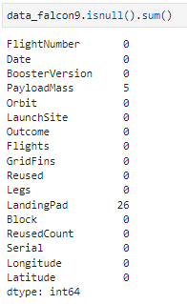
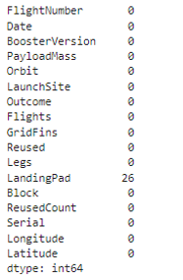
Data collection and data wrangling

Slide 5
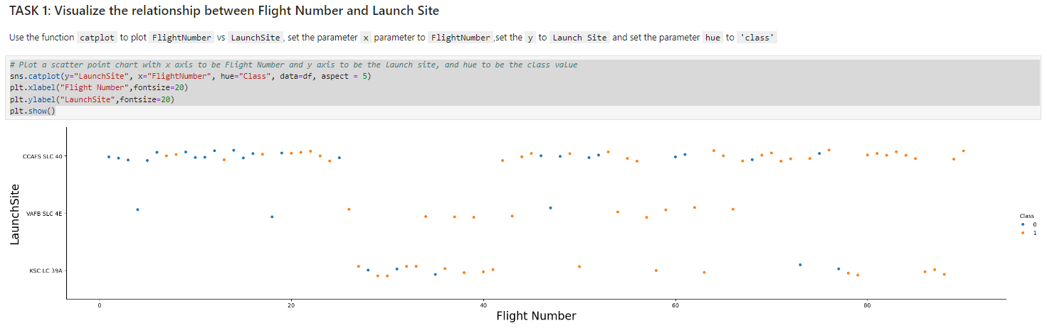
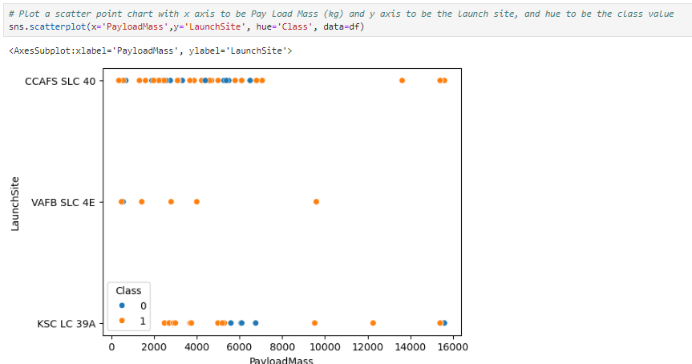
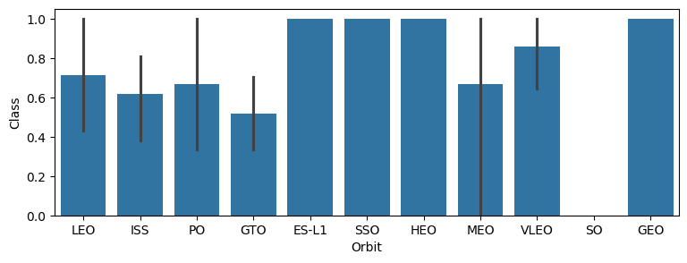
EDA with visualization results
TASK 2: Visualize the relationship between Payload Mass and Launch Site
TASK 3: Visualize the relationship between success rate of each orbit type

Slide 6
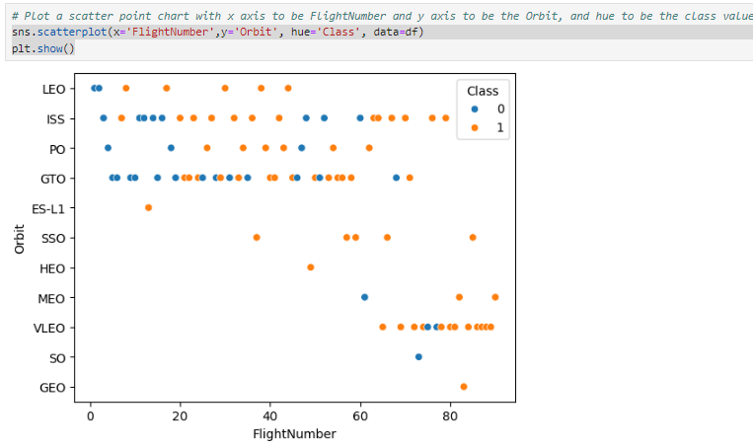
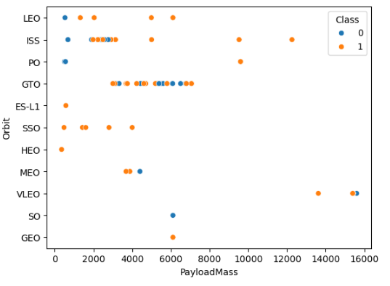
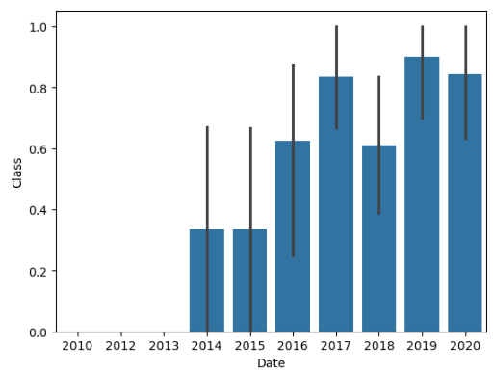
EDA with visualization results
TASK 4: Visualize the relationship between FlightNumber and Orbit type
TASK 5: Visualize the relationship between Payload Mass and Orbit type
TASK 6: Visualize the launch success yearly trend

Slide 7
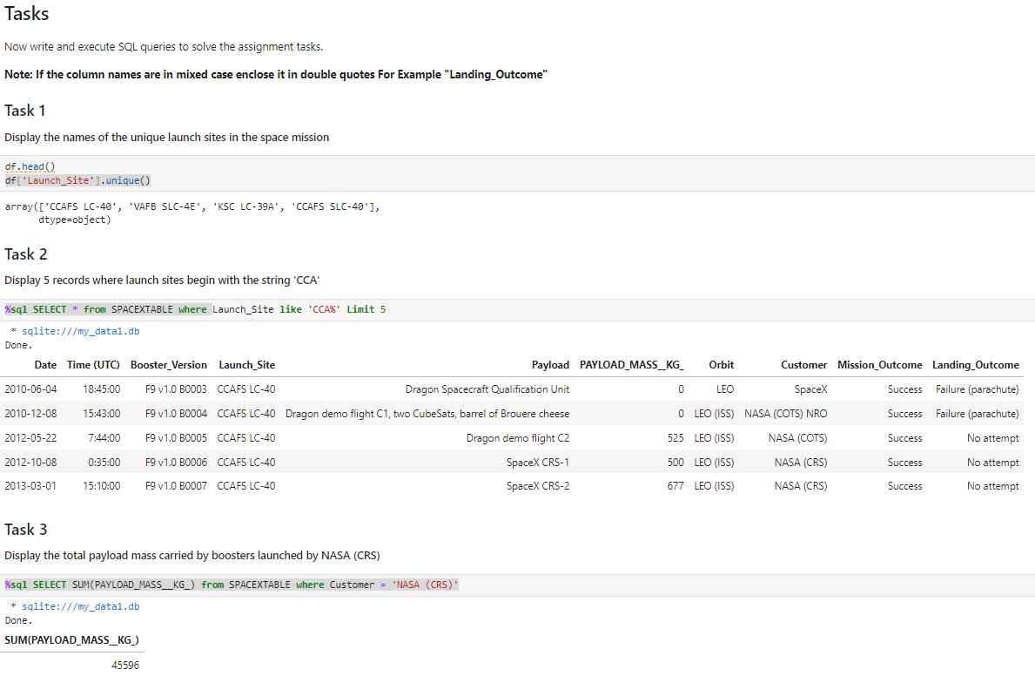
EDA with SQL results

Slide 8
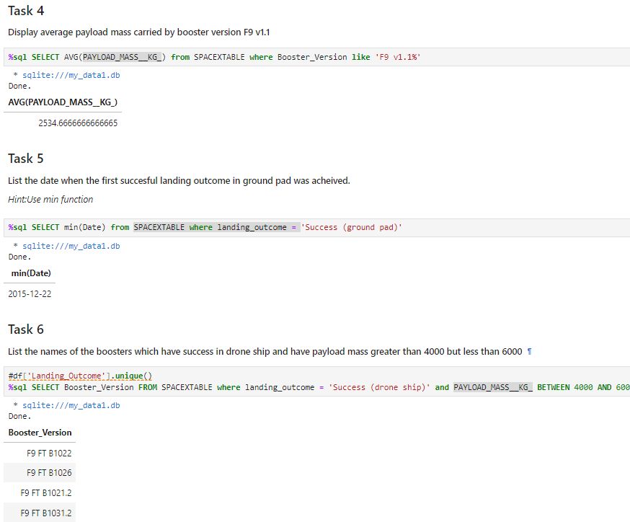
EDA with SQL results

Slide 9
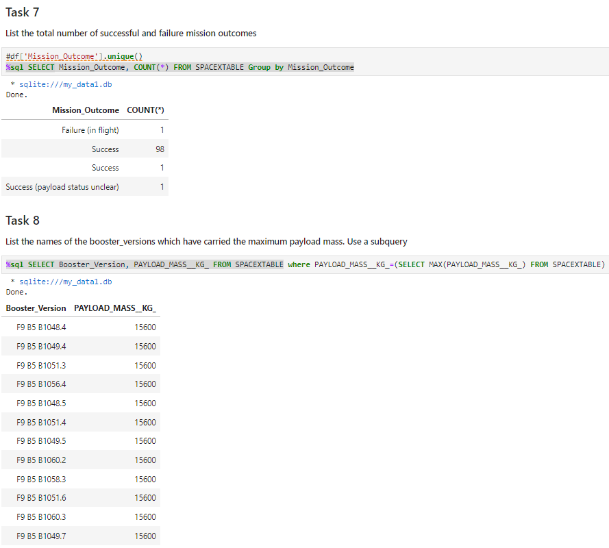
EDA with SQL results

Slide 10
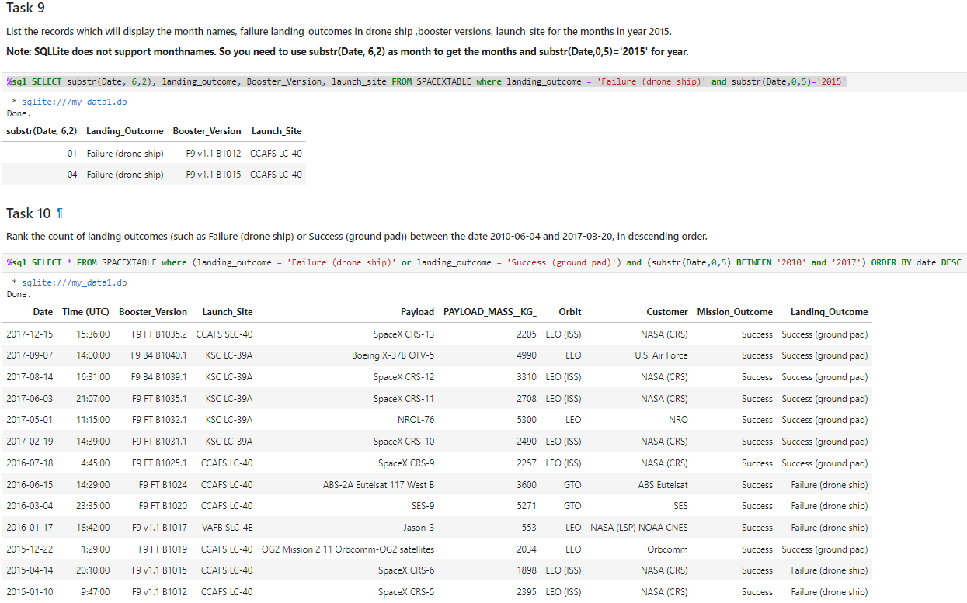
EDA with SQL results

Slide 11
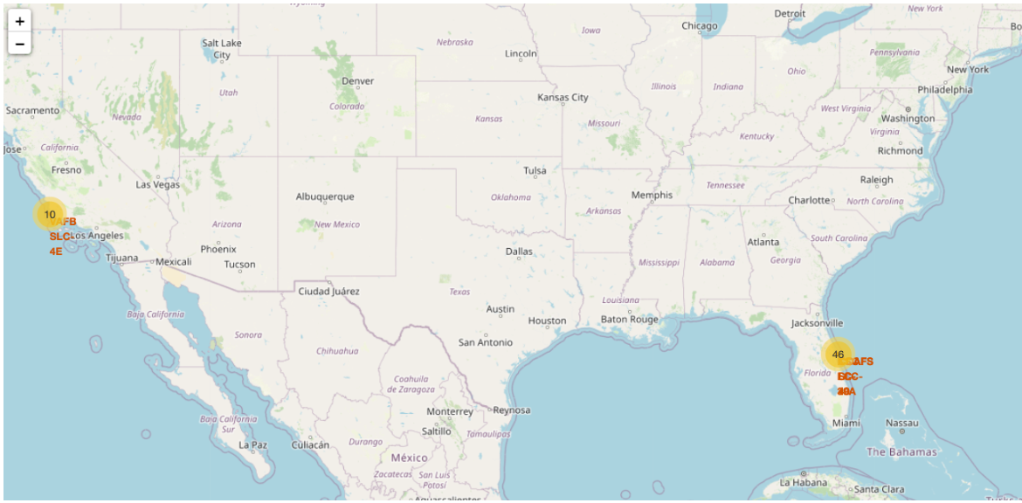
Interactive map with Folium results

Slide 12
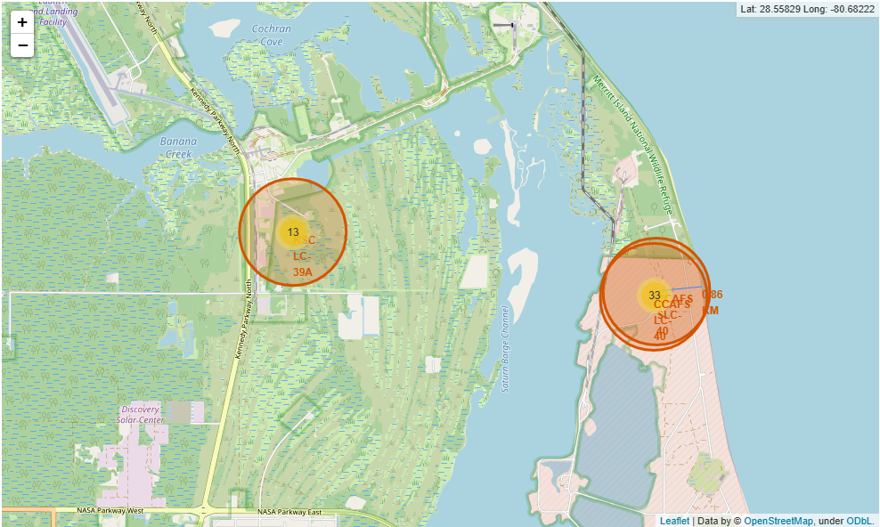
Interactive map with Folium results

Slide 13
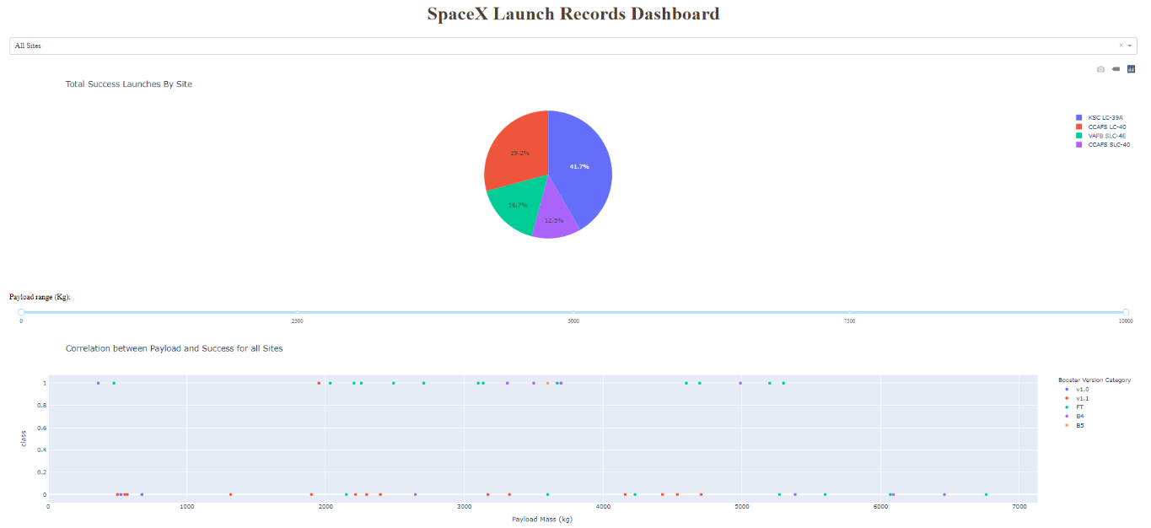
EDA and interactive visual analytics

Slide 14
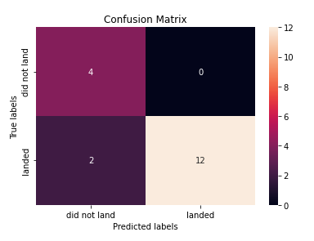
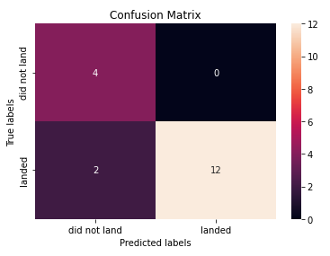
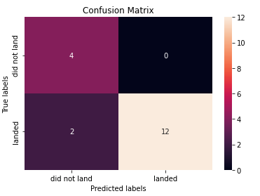
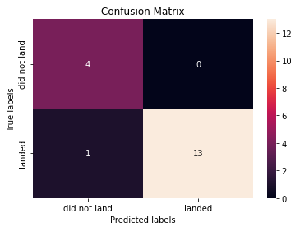
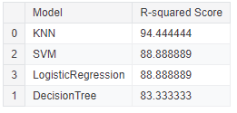
Predictive analysis results
Logistic Regression Model
Support Vector Machine Model
Decision Tree Model
KNN Model
Model Evaluation

Slide 15
Conclusion
SpaceX’s accomplishments include: Sending spacecraft to the International Space Station. Starlink, a satellite internet constellation providing satellite Internet access. Sending manned missions to Space. One reason SpaceX can do this is the rocket launches are relatively inexpensive. SpaceX advertises Falcon 9 rocket launches on its website with a cost of 62 million dollars; other providers cost upwards of 165 million dollars each, much of the savings is because SpaceX can reuse the first stage.

